Slide 1
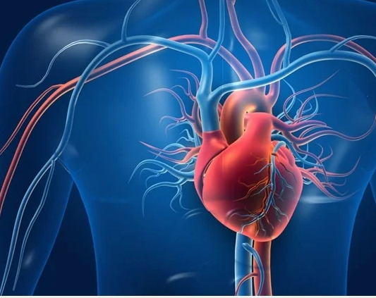
CAN YOU DIE OF A BROKEN HEART? A Predictive Analysis of Potential Risk Factors Associated with Heart Disease
D’Erica Boskie, John Crespo, Sashoya Dougan, Teresa Osorio
MARC Cohort 2023

Slide 2
Introduction
- Heart disease, or Cardiovascular disease, is a term that envelopes several kinds of heart conditions.
- Coronary heart disease
- Cerebrovascular disease
- Peripheral arterial disease
- Heart disease is the leading cause of death in the U.S. causing 1 in 4 deaths and can only be reduced through lifestyle changes and medicine.​
Notes:
Make sure to cite the images with statistiscs !!

Slide 3
Introduction
- In our study we analyzed 300k participants from a Health Status data set collected by the center for disease control (CDC)
- Only 9% of these patients had heart disease so we analyzed balanced data to receive better results
Features = 18
Samples = 300K
Notes:
Make sure to cite the images with statistiscs !!
- Only 9% of these participants had heart disease.

Slide 4
Introduction
- In our study we analyzed 300k participants from a Health Status data set collected by the center for disease control (CDC)
- Only 9% of these patients had heart disease so we analyzed balanced data to receive better results
Features = 18
Samples = 300K
- Detecting and preventing the factors that have the greatest impact on heart disease is very important in healthcare.
- By utilizing machine learning we were able to make inferences about the correlation of heart disease and these features.
Notes:
Make sure to cite the images with statistiscs !!
- Only 9% of these participants had heart disease.

Slide 5
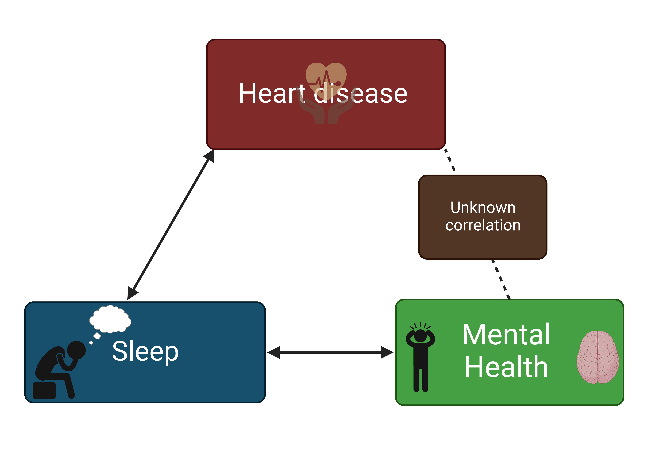
Potential risk factors of Heart Disease
- Various health conditions, lifestyle choices and family history play a part in heart disease
- Key risk factors in heart disease
- High blood pressure
- High cholesterol
- Smoking
- Our study looked at 17 features that had the potential to relate to heart disease​
- Sleep Time​
- Mental Health
- No significant correlation between mental health and heart disease.​
Notes:
- Understanding the features that relate to heart disease could allow for further investigation of potential risk factors of heart disease.
- There is a correlation between heart disease and sleep, and sleep to mental health.

Slide 6
Objective and Hypothesis
Is there an association between features such as sleep time and mental health in heart disease diagnosis?
We hypothesize that sleep and mental health are independently associated with heart disease patients.
We aim to use supervised machine learning, Random Forest, as an algorithm to elucidate the relationship between mental health and heart disease diagnosis.
Notes:
Importance understanding factors that contribute to heart disease allows us to target these factors, which could decrease the likelihood of developing heart conditions.

Slide 7
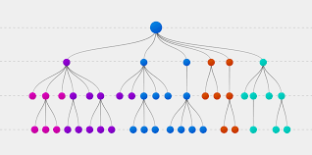
What is Random Forest?
- An algorithm used in supervised machine learning
- Uses many decision trees and takes a majority vote of the results to make...
- a final decision – categorical
- an average – regression
- Less bias and variance than Decision Tree

Slide 8
What is Random Forest?
- An algorithm used in supervised machine learning
- Uses many decision trees and takes a majority vote of the results to make...
- a final decision – categorical
- an average – regression
- Less bias and variance than Decision Tree
Boruta Algorithm​
- Precedes the Random Forest algorithm​
- Selects and discards features based on importance to the model ​

Slide 9
Methods
- Process Data
- Convert categorical data into factored data types
- Select Important features using Boruta algorithm

Slide 10
Methods
- Process Data
- Convert categorical data into factored data types
- Select Important features using Boruta algorithm
- Build Random Forest Model
- The data was very unbalanced – only 9% reported heart disease
so we were provided with a balanced dataset

Slide 11
Methods
- Process Data
- Convert categorical data into factored data types
- Select Important features using Boruta algorithm
- Build Random Forest Model
- The data was very unbalanced – only 9% so we were provided with a balanced dataset
- Out of Bag Error– Uses 1/3 of data that was not used to train the decision trees.
- Estimate error rate of the algorithm based on mtry (# of variables randomly sampled at split).
- We choose the mtry with the lowest error rate

Slide 12
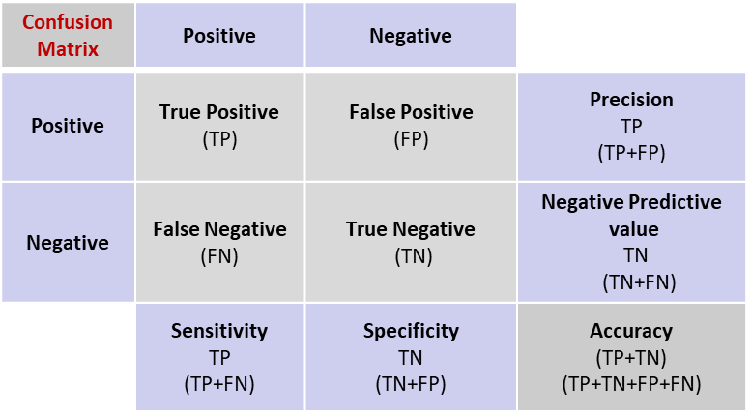
Methods
- Process Data
- Convert categorical data into factored data types
- Select Important features using Boruta algorithm
- Build Random Forest Model
- The data was very unbalanced – only 9% so we were provided with a balanced dataset
- Out of Bag Error– Uses 1/3 of data that was not used to train the decision trees.
- Estimate error rate of the algorithm based on mtry (# of variables randomly sampled at split).
- We choose the mtry with the lowest error rate
- Confusion Matrix
- Determine the accuracy and precision of the model

Slide 13
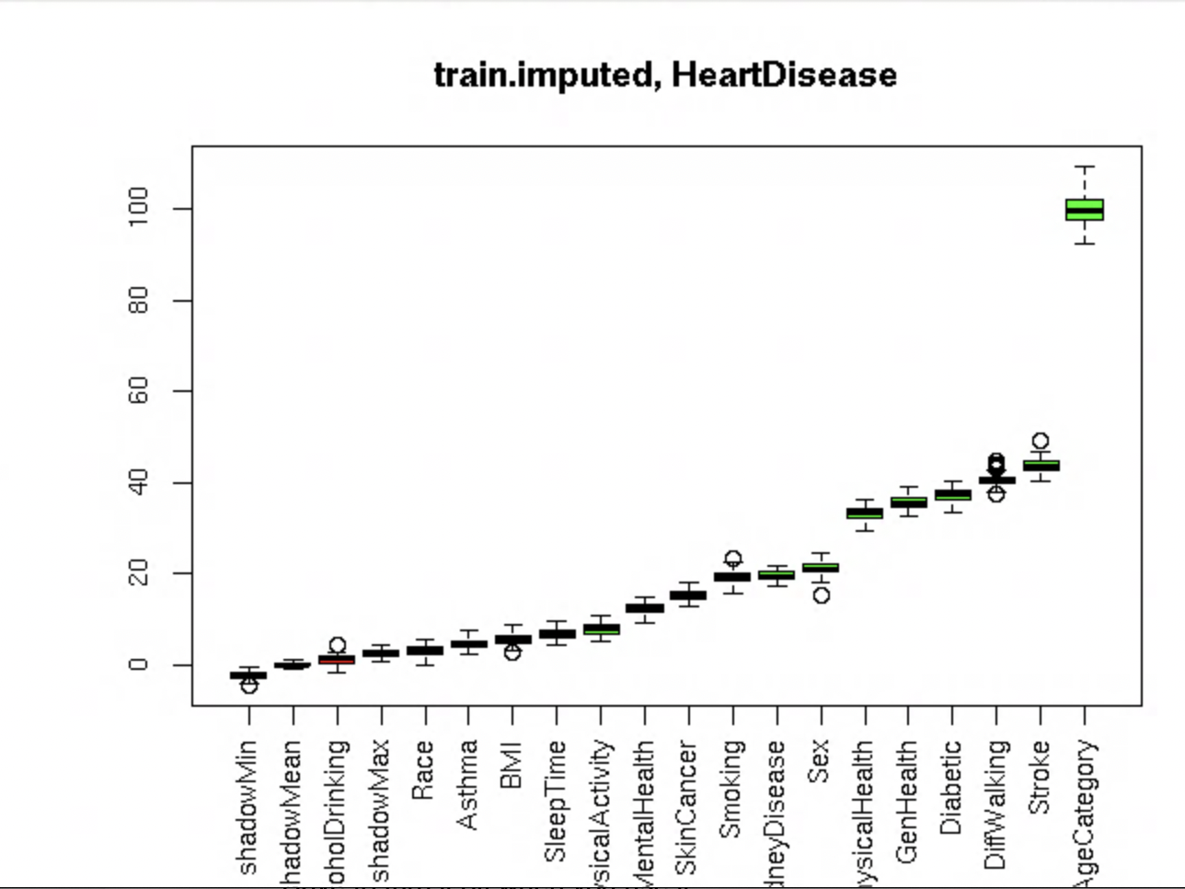
Identifying potential contributors of heart disease
- Age is a key factor in heart disease progression.
- In addition, stroke, smoking and diabetes are well described to contribute to heart disease.
- How can the information collected from machine learning algorithms be used to identify indirect or direct features of heart disease?
Significance
Features

Slide 14
Measuring potential contributors of heart disease
Measuring the importance of
potential heart disease contributors
- The removal of various factors such as age, diabetes, and general health reduces the accuracy of the dataset.
- How can we investigate the relationship of other factors such as sleep and mental health in patients with heart disease?
Features
Mean Decrease Accuracy
Notes:
A.) Age plays a significant role in predicting heart disease
B.) Mental Health has higher mean decrease accuracy compared to Sleep Time
Illustrating the removal of mental health from the data will lower the accuracy of the dataset (left figure)
Gini is measured, which shows that the higher the value of mean decrease accuracy, the higher the importance of the variable in the model

Slide 15
Mental Health has higher mean decrease accuracy of machine learning model compared to Sleep Time
- The removal of mental health from the dataset will lower the accuracy of predicting if a patient has or doesn’t have heart disease the machine learning model.
- Investigating partial dependence will provide us more insight of the association of sleep and mental health in heart disease diagnosis.
Features
Mean Decrease Accuracy of ML Model
Notes:
Mental Health has higher mean decrease accuracy compared to Sleep Time
Illustrating the removal of mental health from the data will lower the accuracy of the dataset (left figure)
Gini is measured, which shows that the higher the value of mean decrease accuracy, the higher the importance of the variable in the model

Slide 16
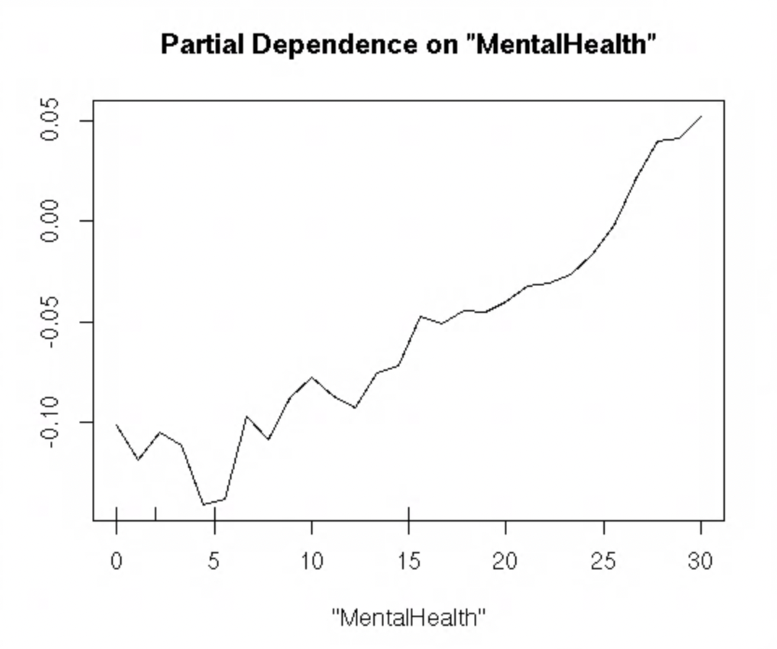
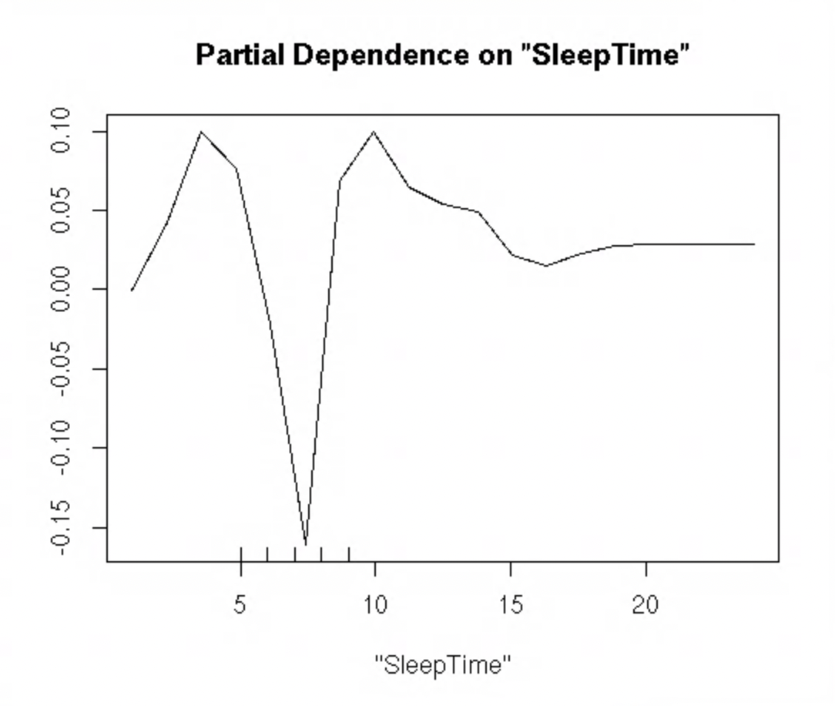
Association of mental health and sleep to heart disease
A.)
Patients who reported more days affected by poor mental health have a higher incidence of heart disease.
Patients who reported sleeping for 7-8 hours had the lowest likelihood of heart disease by the algorithm.
Notes:
Thinking about your mental health, for how many days during the past 30 days was your mental health not good? (0-30 days)

Slide 17
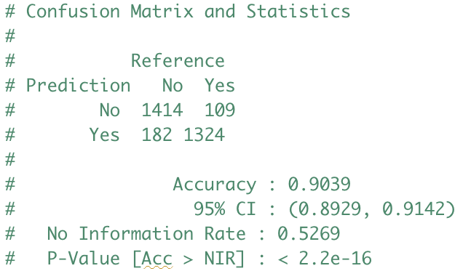
Conclusions
- We can conclude, mental and sleep play a role in predicting with heart disease.
- Confusion Matrix demonstrates we were able to develop a machine learning model that accurately predicts and assess association of features with heart disease.
~ 90% accurate

Slide 18
Future Directions
How can we utilize the ML model we designed to uncover the association of various factors with heart disease?
Use the model with variety of datasets.
Conducting such research can allow researchers and medical doctors to elucidate therapeutic options and measures for treating and preventing heart disease.
Encouraging further research into the association of mental illness, sleep and heart disease

Slide 19
Acknowledgements
We would like to thank:
Dr. Kwangwon Lee and Dr. Nathan Fried, MARC
- Galen Collier and Udi Zelzion, Rutgers Research Computing
- Tom Skipper
- NIH MARC program
- And Rutgers-University Camden Biology Department

Slide 20
References
Al'Aref SJ, Anchouche K, Singh G, Slomka PJ, Kolli KK, Kumar A, Pandey M, Maliakal G, van Rosendael AR, Beecy AN, Berman DS, Leipsic J, Nieman K, Andreini D, Pontone G, Schoepf UJ, Shaw LJ, Chang HJ, Narula J, Bax JJ, Guan Y, Min JK. Clinical applications of machine learning in cardiovascular disease and its relevance to cardiac imaging. Eur Heart J. 2019 Jun 21;40(24):1975-1986. doi: 10.1093/eurheartj/ehy404. PMID: 30060039.
Bang JS, Jo S, Kim GB, Kwon BS, Bae EJ, Noh CI, Choi JY. The mental health and quality of life of adult patients with congenital heart disease. Int J Cardiol. 2013 Dec 5;170(1):49-53. doi: 10.1016/j.ijcard.2013.10.003. Epub 2013 Oct 11. PMID: 24139784.
Izawa KP, Watanabe S, Oka K, Hiraki K, Morio Y, Kasahara Y, Osada N, Omiya K, Shimizu H. Association between mental health and physical activity in patients with chronic heart failure. Disabil Rehabil. 2014;36(3):250-4. doi: 10.3109/09638288.2013.785604. Epub 2013 Apr 25. PMID: 23614372.
Kivimäki, M., Steptoe, A. Effects of stress on the development and progression of cardiovascular disease. Nat Rev Cardiol 15, 215–229 (2018).
Khalilia, M., Chakraborty, S. & Popescu, M. Predicting disease risks from highly imbalanced data using random forest. BMC Med Inform Decis Mak 11, 51 (2011). https://doi.org/10.1186/1472-6947-11-51

