Slide 1
Heart Disease
Sandy Lam, Blessing Awogbamila, Rosemarie Arroyo-Martinez, Emma Zeitler
MARC Cohort 2024 - Bioinformatics Bootcamp
Notes:
sandy

Slide 2
Overview
01
02
03
04
05
Heart Disease
Machine Learning
Research Question
Introduction and why it is important
What is machine learning? How did we use it?
What question did we seek to answer?
Data Analysis
Importance
What we found?
How the data is relevant
Notes:
sandy

Slide 3
01
Heart Disease
34 seconds
1 in 5 people
$229 billion
1 person dies every 34 seconds from a cardiovascular disease.
Heart disease is the leading cause of death in the United States. That is about 697,000 people.
Cost of healthcare services dedicated to heart disease treatment.
Notes:
sandy

Slide 4
02
What is Bioinformatics?
The application of computational tools in the analysis of biological data
Involves the management and analysis of large collections of data
A great example would be the large data sets of patients in medical care
Notes:
Bioinformatics is The application of tools of computation and analysis to interpret biological data. Basically it uses computer technology collect, store, and analyze biological data.Its essential for managing large sets of data. A great example would be the large data sets of patients in medical care. Let's say 300,000 patients had a particular disease, using machine learning technology, you could predict certain patterns, conditions, or habits that are associated with a disease.
blessing

Slide 5
Machine Learning (ML)
ML is a subset of artificial intelligence
Defined as the capability of a machine to imitate human intelligence and to learn without explicit instruction by using algorithms and statistical models
Used for data analysis and draws inferences from patterns in data
Notes:
Blessing

Slide 6
03
Does gender, race, and age contribute to heart disease?
Notes:
sandy

Slide 7
Unsurprisingly, heart disease is more prominent in the older generation. The risk of heart disease is higher in the Native American and Black community specifically in males than women even if the mortality rate for women is higher.
Notes:
sandy

Slide 8
04
Methodology
ML algorithms was used to analyze heart disease data and how age, sex, and race impacted the accuracy of heart disease prediction.
Amarel Cluster was used as a means to access R (programming language) to analyze data - access permitted by the Office of Advanced Research Computing (OARC)
Packages Used: RandomForest, Boruta, ROSE, mlbench, caret, ROCR
Notes:
https://oarc.rutgers.edu/resources/amarel/
sandy

Slide 9
Pipeline of Machine Learning Method
Acquire data (provided by CDC)
Prepare data (clean and balance data)
Choose model (classification model Y/N)(categorizes data to draw conclusion )
Train the model (passed the prepared data to ML model)
Evaluate the model (done during training stage)
Parameter tuning (make adjustments to optimize model)
Run model on test data set
Use the model in making predictions with new data set
Notes:
1.In this instance, the data was provided by the 2020 annual CDC survey data of 400k adults related to their health
2. The raw data given needs to be cleaned and distributed evenly.
3It is an algorithm that is used to map the input data to a specific category
4.In training, you pass the prepared data to your machine learning model to find patterns and make predictions
8. For example if you were given data from a different hospital, or a hospital from a different country you could use this model and compare the information
blessing

Slide 10
Attributes
Heart Disease (Y/N)
Body Mass Index (BMI)
Smoking (Y/N)
Alcohol Drinking (Y/N)
Stroke (Y/N)
Physical Health
Mental Health
Difficulty Walking (Y/N)
Sex (M/F)
Age Category
Race
Asthma (Y/N)
Sleep Time
Physical Activity
General Health
Kidney Disease (Y/N)
Skin Cancer (Y/N)
Diabetic (Y/N)
**Data provided by the CDC**
Notes:
emma

Slide 11
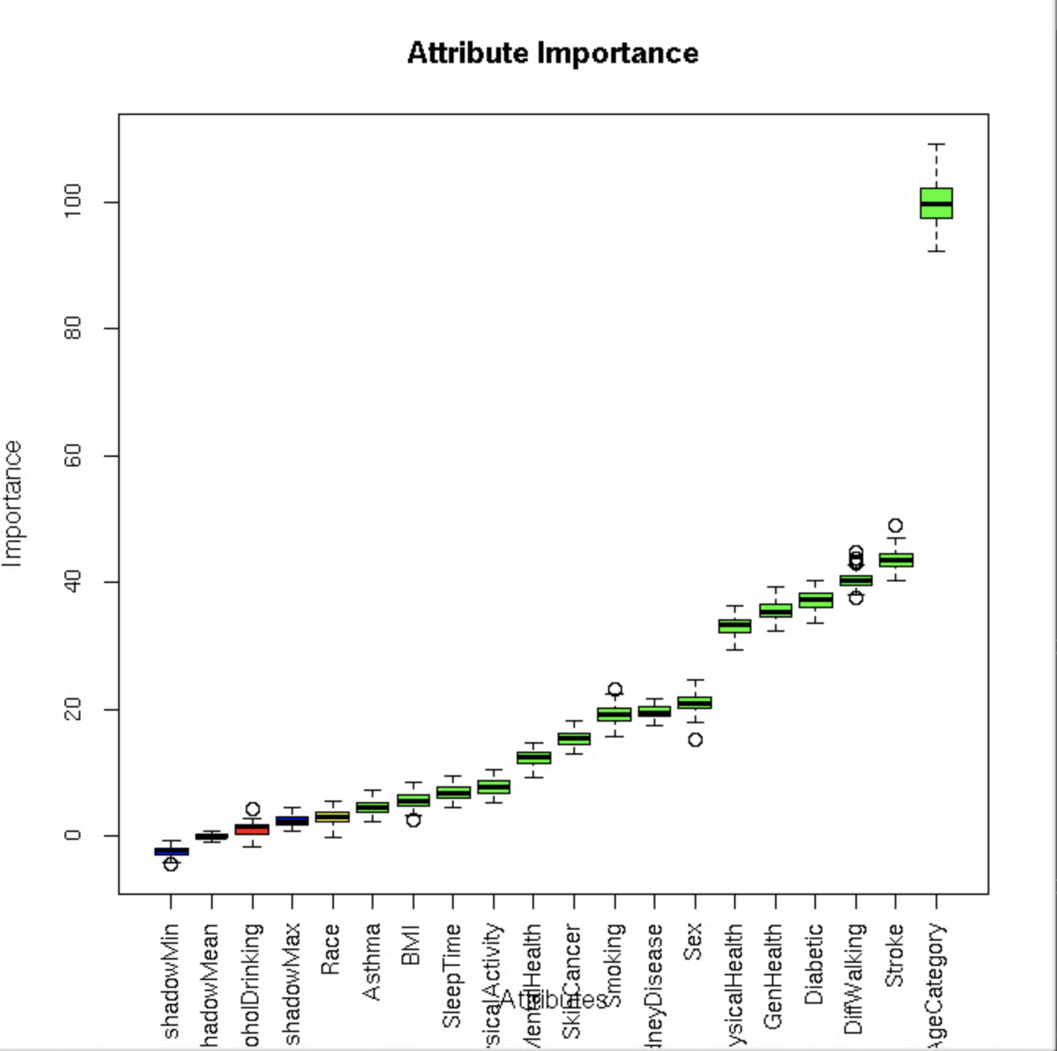
Factors
All attributes but alcohol drinking were found to be important
Age, stroke, difficulty walking, diabetes, and general health were found to be the five most useful attributes in heart disease prediction
**Data provided by the CDC**
Notes:
emma

Slide 12
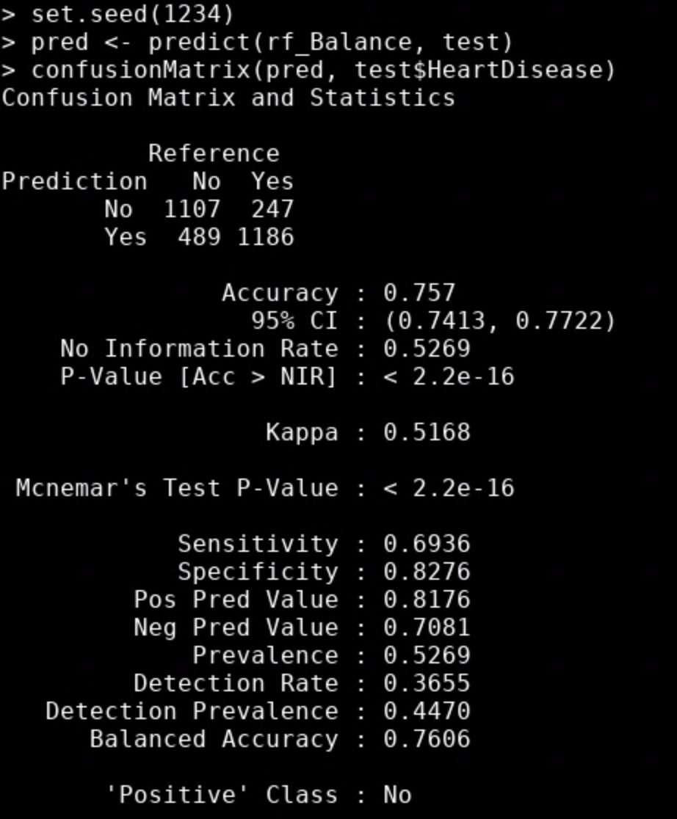
Accuracy of Model
After training the machine, it calculated the accuracy of heart disease prediction
75.7%
**Data provided by the CDC**
Notes:
Accurately sorted cases with or without heart disease divided by all cases.
Lower than we would have liked but given the smaller sample size, it is not a bad percentage.
emma

Slide 13
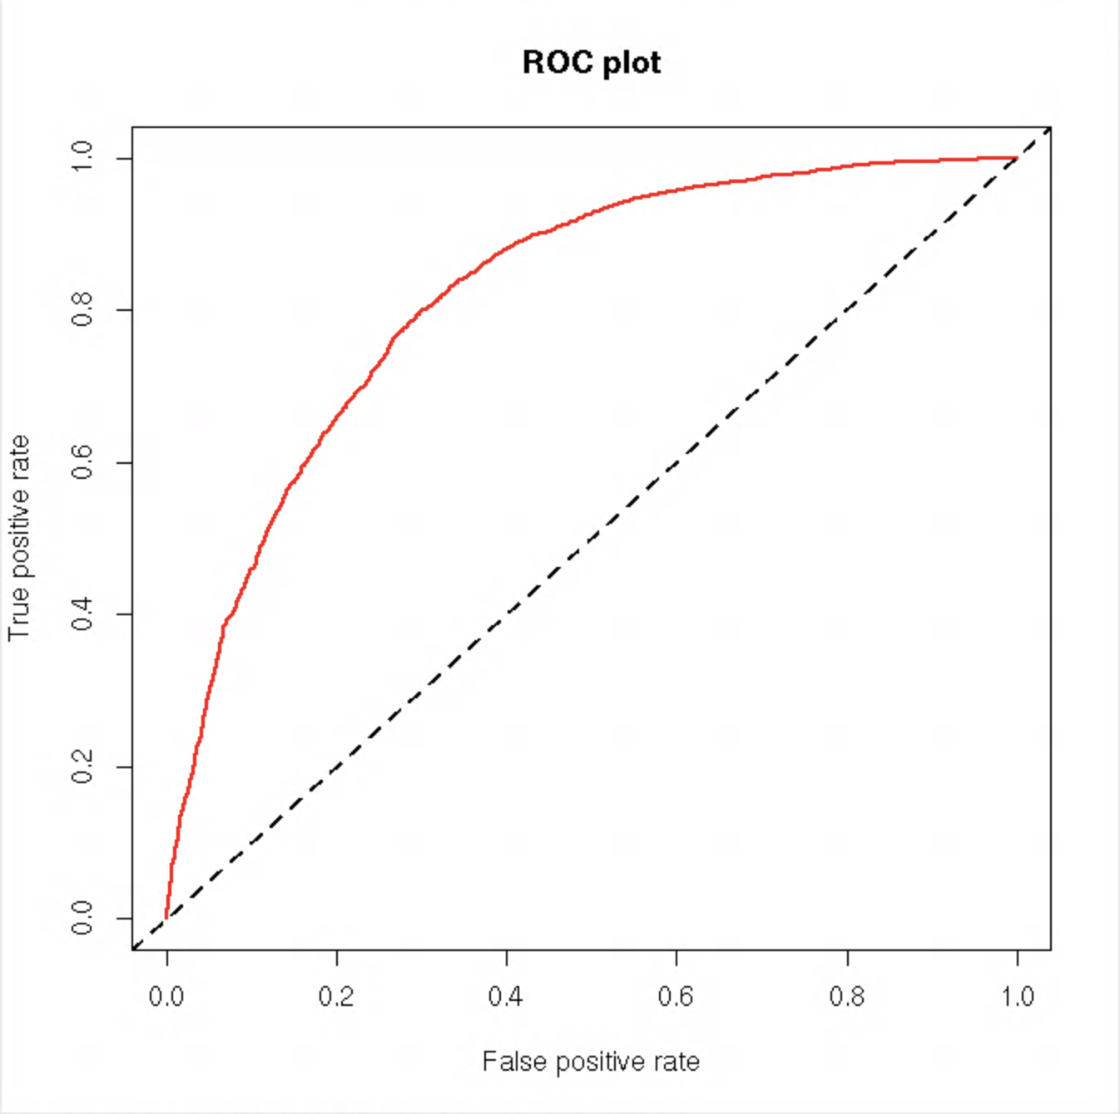
ROC Curve
Receiver operating characteristic curve compares the true positive rate to the false positive rate
Area under the curve (AUC)- 0.8198941
The closer to 1, the more accurate
**Data provided by the CDC**
Notes:
emma

Slide 14
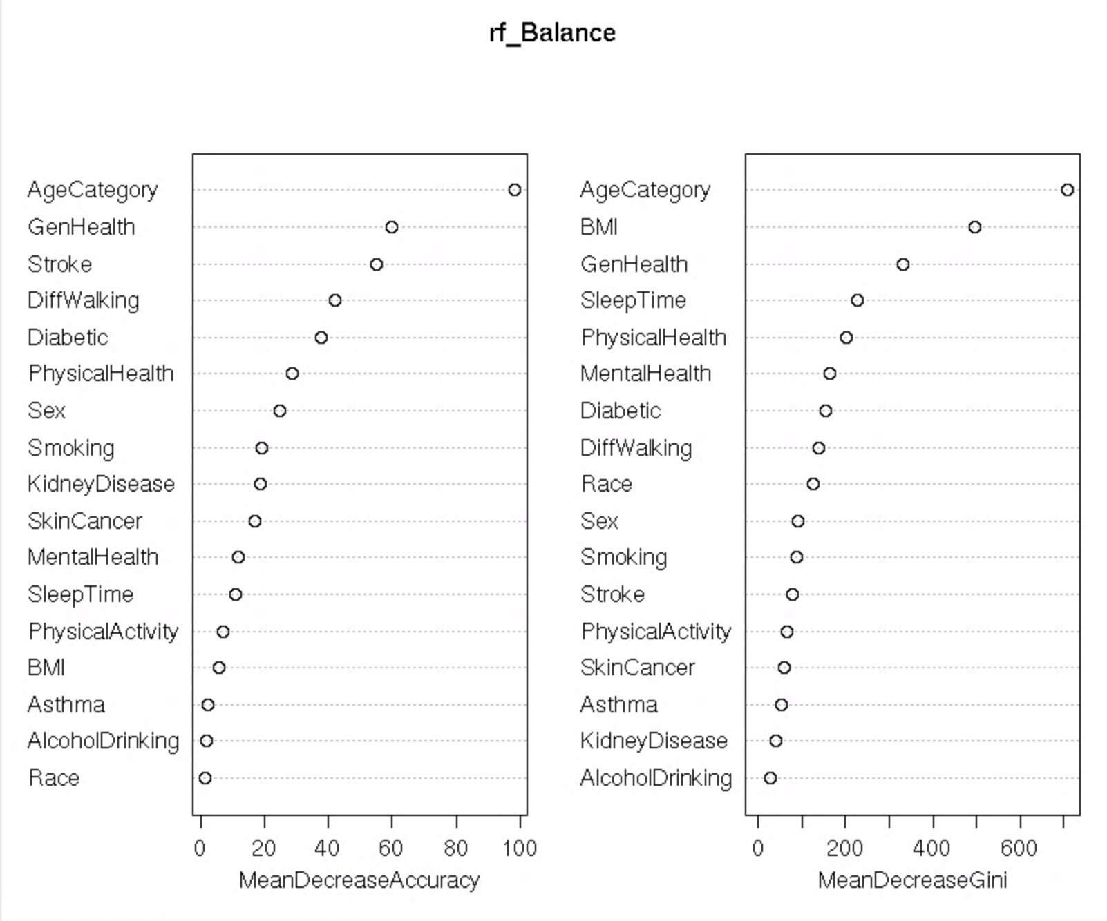
Mean Decrease Accuracy
Mean Decrease Accuracy- how much accuracy decreases if that attribute was removed
Mean Decrease Gini- measure of variable importance based on the Gini Impurity Index
**Data provided by the CDC**
Notes:
emma

Slide 15
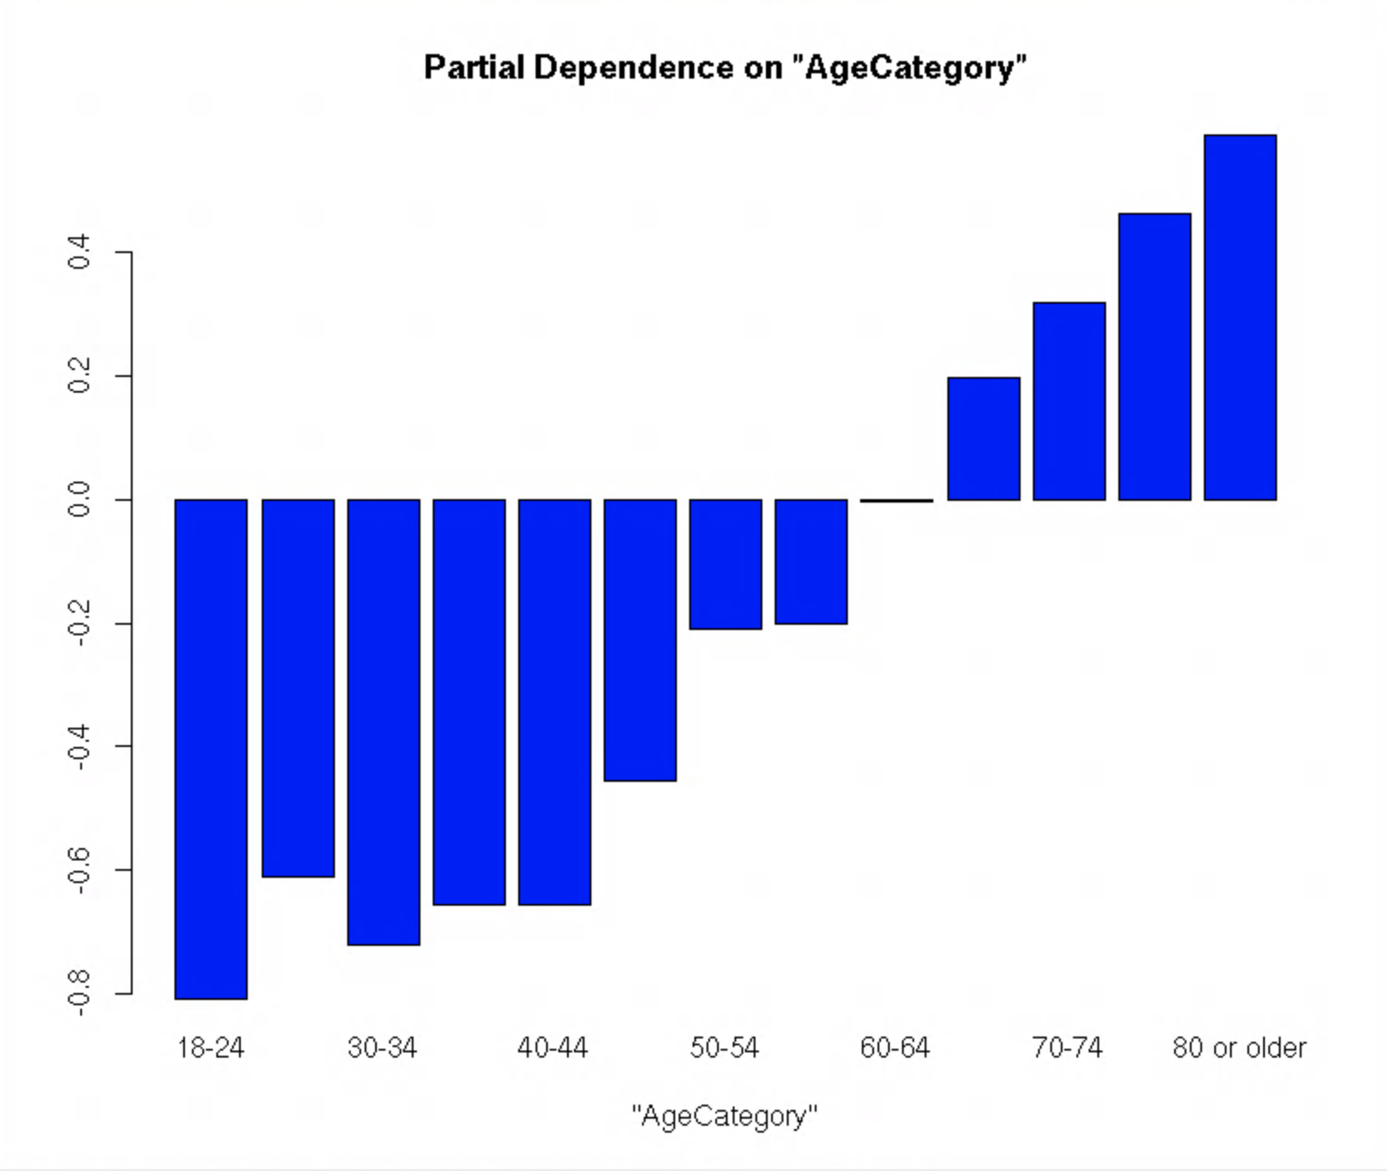
Partial Dependence on Age
Indicates at which age group is more likely to develop heart disease
People between the ages of 18 and 24 were least likely to develop heart disease
People 60 and older are progressively more likely to develop heart disease as they age
**Data provided by the CDC**
Notes:
Rose

Slide 16
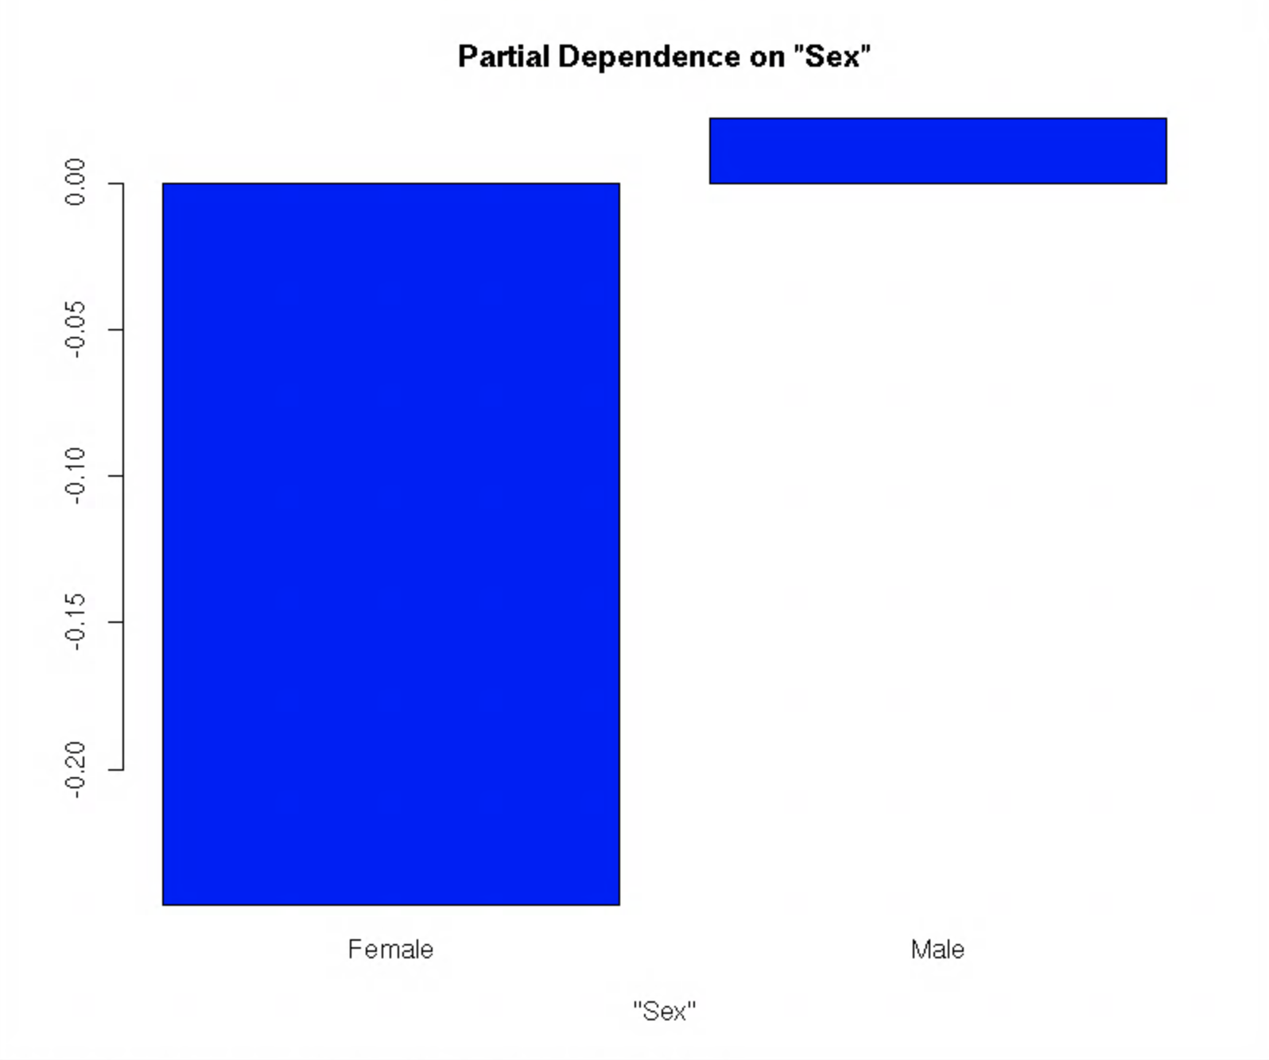
Partial Dependence on Sex
Indicates which sex is more likely to develop heart disease
Men are more than likely to develop heart disease than women
Notes:
Rose

Slide 17
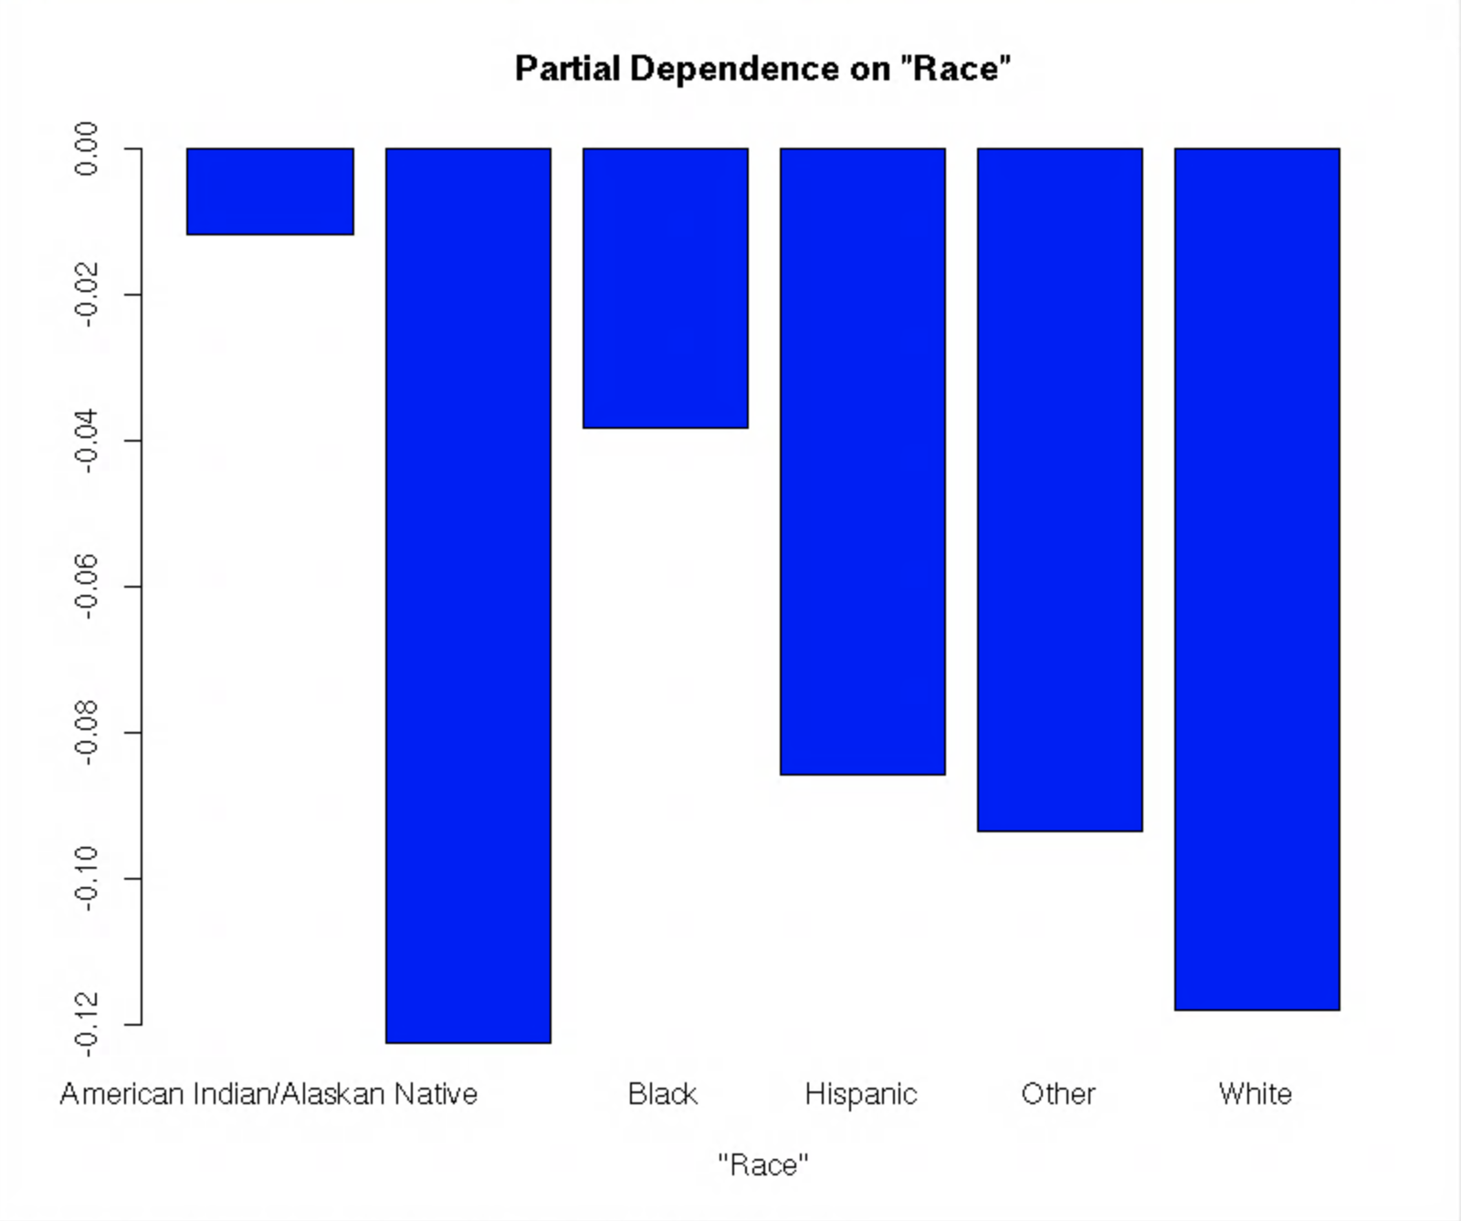
Partial Dependence on Race
Indicates which races are more likely to develop heart disease
People of White or Asian Descent are the least likely to develop heart disease, while Black and Native Americans are more likely to develop heart disease
Asian
Notes:
Rose

Slide 18
Comparison
**Data provided by the CDC**
Notes:
Rose

Slide 19
Conclusion
Previous studies has shown that age, sex, and race are indicators of heart disease. Based on our data analysis, race was not shown to be a major contributor in the prediction of heart disease; however, it was useful in increasing the accuracy of our model. Age and sex very both found to be major predictors of heart disease, in line with previous studies.
Notes:
Based on previous articles what we read, race was repeatedly mentioned.
Blessing

Slide 20
05
Machine Learning & Heart Disease
As a leading cause of death in many countries, patients require quick diagnosis and early treatment
Machine learning can be used to analyze previous heart disease data to predict future cases, expediting diagnosis
Notes:
emma

Slide 21
Test & Trials
New programming language
First time with machine learning
HPC environment
Maintenance limited time that was allotted to work
Troubleshooting
Teamwork
Notes:
sandy

Slide 22
Acknowledgements
OARC (Office of Advanced Research Computing)
Galen Collier
Udi Zelzion
MARC U*STAR Program
Kwangwon Lee
Nathan Fried
Notes:
sandy

Slide 23
References
Amarel. Office of Advanced Research Computing. (2022, July 8). Retrieved August 18, 2022, from https://oarc.rutgers.edu/resources/amarel/
Centers for Disease Control and Prevention. (2022, July 15). Heart disease facts. Centers for Disease Control and Prevention. Retrieved August 18, 2022, from https://www.cdc.gov/heartdisease/facts.htm
“Heart Disease Risk: How Race and Ethnicity Play a Role.” Cleveland Clinic, https://my.clevelandclinic.org/health/articles/23051-ethnicity-and-heart-disease. Accessed 18 Aug. 2022.
“Rodgers, Jennifer L., et al. “Cardiovascular Risks Associated with Gender and Aging.” Journal of Cardiovascular Development and Disease, vol. 6, no. 2, Apr. 2019, p. 19. PubMed Central, https://doi.org/10.3390/jcdd6020019.
“The Complete Guide to Machine Learning Steps.” Simplilearn.Com, https://www.simplilearn.com/tutorials/machine-learning-tutorial/machine-learning-steps. Accessed 18 Aug. 2022.
Yazdani, Armin, et al. “A Novel Approach for Heart Disease Prediction Using Strength Scores with Significant Predictors.” BMC Medical Informatics and Decision Making, vol. 21, no. 1, June 2021, p. 194. BioMed Central, https://doi.org/10.1186/s12911-021-01527-5.

